Slide 1
Unistyles (v3)
© Copyright 2023 NearForm Ltd. All Rights Reserved.

Slide 2
Why we start to use it

Slide 3
Behind the choice
We were using Styled components to build UI components in the project.
Themed
Easy to use also with imported component
No typed
CSS like syntax can be misleading
After the deprecation of Styled components, we decided to looking for something with the same Pros but possibly without the flaws of styled component.

Slide 4
Why Unistyles
Unistyles was created as a super set of RN Stylesheet
Looks familiar
Typed
Using the same Stylesheet signature it is quite immediate to use.
Typos or misspelling errors are marked.
Themed
Runtime values
Unistyle accept multiple themes without a specific syntax.
It is necessary anyway to specified a proper type for the theme.
Unistyles injects some runtime values with the theme (f.i. A value to tell if the device is in landscape mode or not) so the style can be managed in a single place.
Style can be defined as function as well in order to pass custom values.

Slide 5
How it works under the hood
A Babel plugin scans the Stylesheet and understood the dependencies for each styles
At this point, StyleSheets are reconstructed on the C++ side and stored in native C++ StyleSheets registry, containing the parsed Unistyles. In this way Unistyles knows exactly which StyleSheet is static, which depends on a theme
When an event occurs, the algorithm scans the registry and looks for styles depending on the event. At the point the necessary styles are re-computed and only the specific node in the ShadowTree is targeted and updated.
The Babel plugin processes the components through to borrow refs and bind the ShadowNode with Unistyle
More info

Slide 6
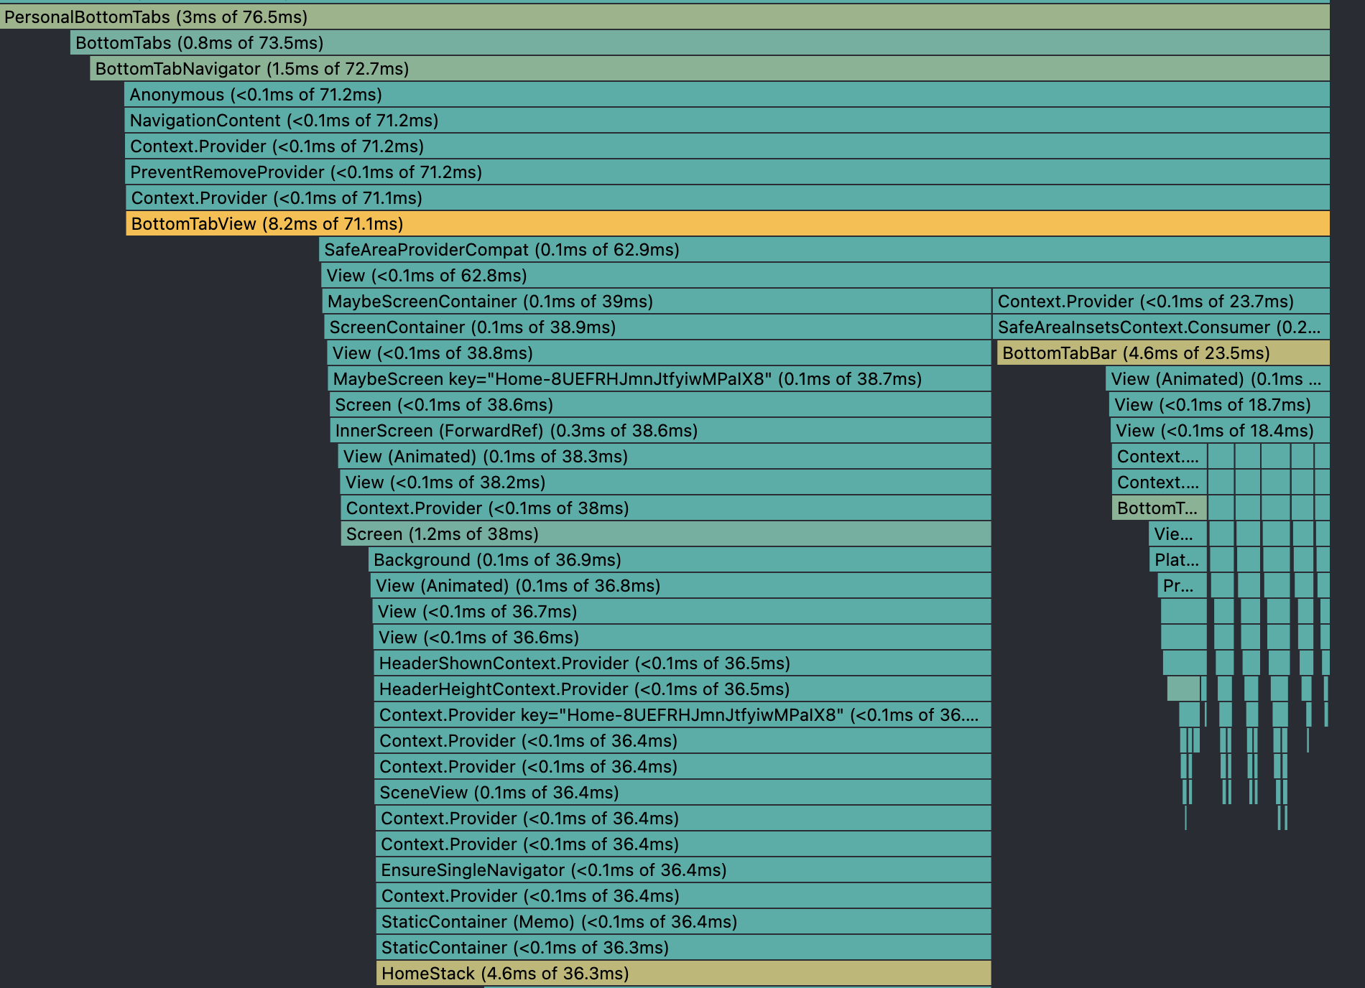
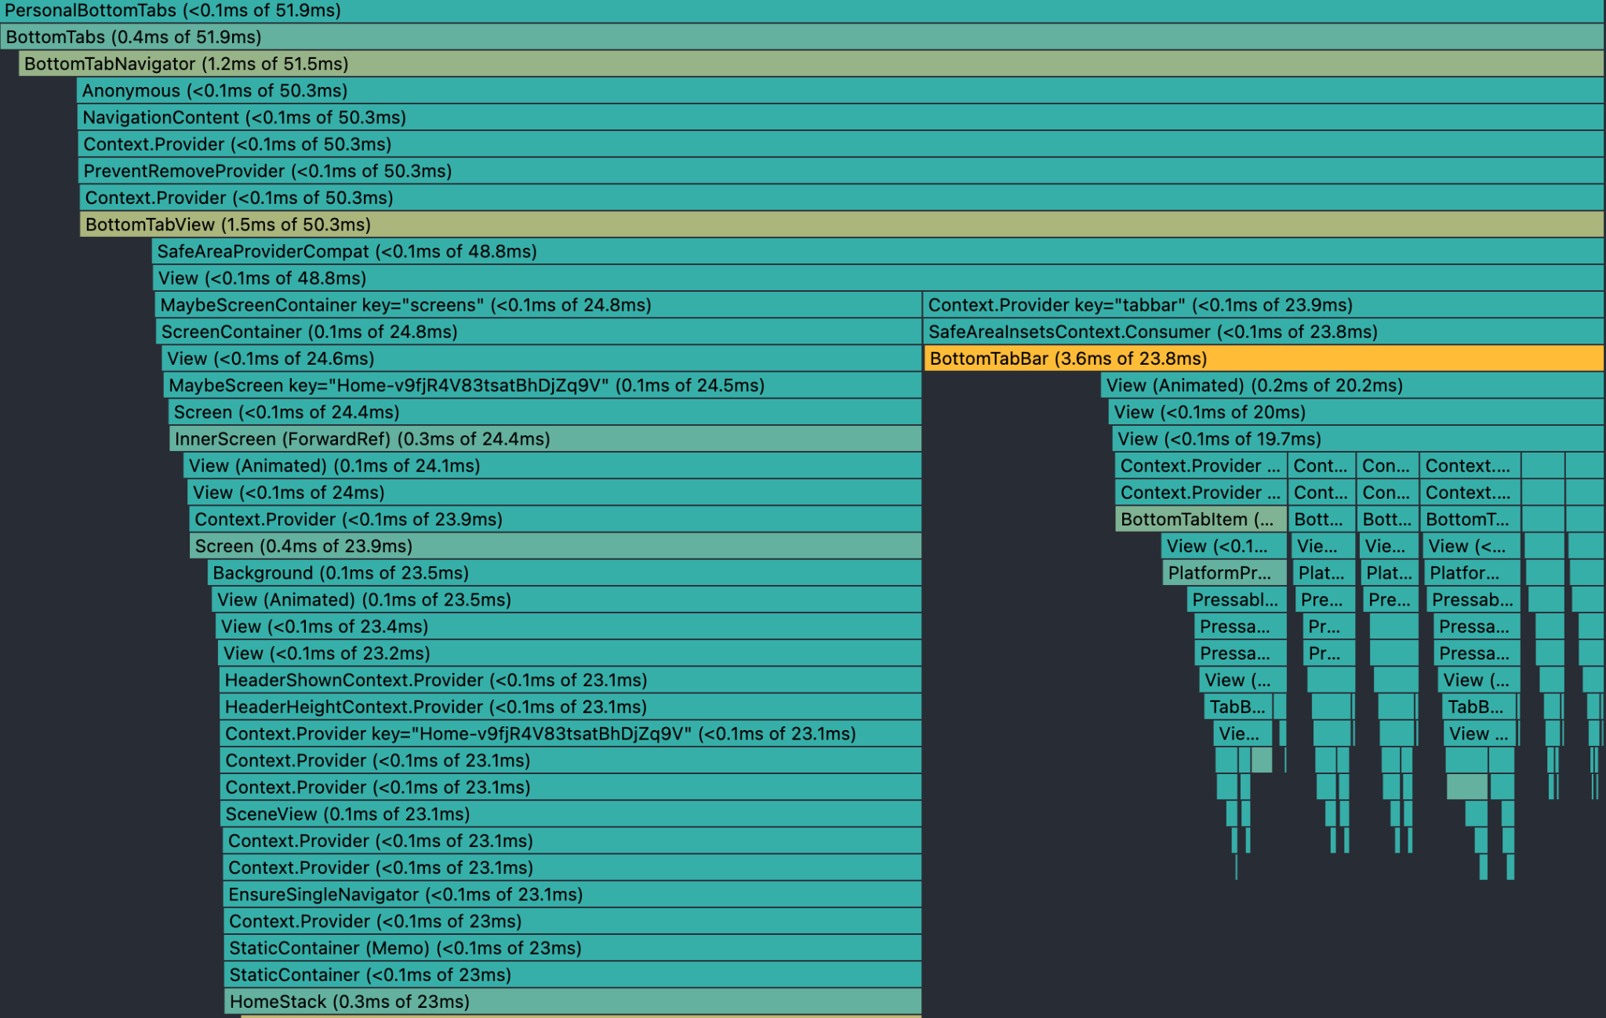
Performances
Before
After

Slide 7
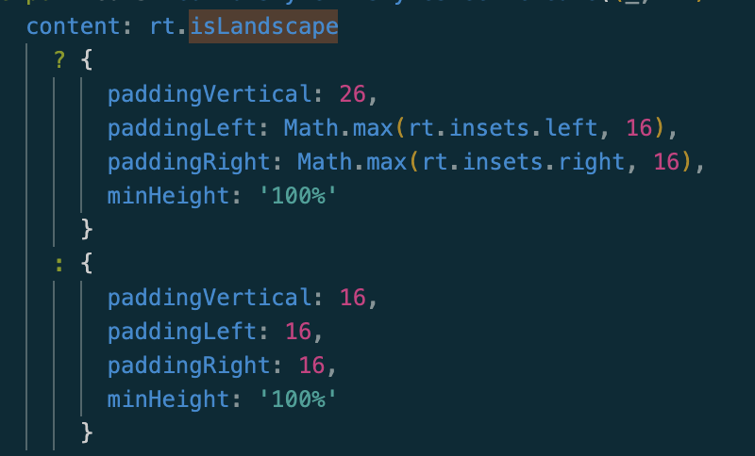
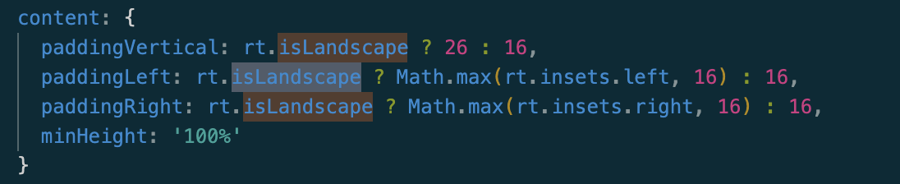


Not all the glitters are gold
We had some issues with the recalculation after an event.
Changing the whole object to update a style based on an event seems to not work
2. Similarly sometimes it is necessary a little workaround to provoke a rerender. We open an issue for it.

Slide 8
Code

Slide 9
Questions?

